Slide 1




CSM4994-Industrial Project Development
S56876 - Nadzmi Bin Jasni

Slide 2

TABLE OF CONTENTS
01 Introduction | 05 New knowledge/experience
02 Project Requirements | 06 Issue and limitations
03 Technical Implementation of the project | 07 Lesson learned
04 Details list of deliverables/output | 08 Conclusion

Slide 3
Introduction
Overview of the project
Summary of the deliverables/achievements

Slide 4
Overview of the project
The Cyber Security Health Check Programme (CSHCP) or Program Galakan Pemerkasaan Keselamatan Siber (PGPKS) is a comprehensive program that delivers cyber security services and approaches to solve increasingly sophisticated cyber threats. In this scenario, Cyber Security Malaysia (CSM) is the primary actor in this system because they will monitor, organize, and report on PGPKS's progress. They must employ a system that can monitor progress.
The purpose of this system is for managing user tasks in a more systematic and effective manner. Instead of performing it manually, which will take a long time, we may use this approach which would save us money on paper and time. This system should have helped CSM monitor SME and Authorized Partners, and track PGPKS progress.

Slide 5
Summary of the deliverables/achievements
Requirement specification
Admin/CSM can manage the authorize partners.
Design and analysis
Create form register for Authorize partners.
Development
Create MySQL database and connect it to the system.
Testing
Check the system components functionality by testing it and fix bug.

Slide 6
Project Requirement

Slide 7
Project Requirement
Monitor service offering Authorize Partner and SMEs
Import and export excel file record SMEs and
Create authentication access for Admin and Authorize Partner
Authorize Partner can upload reports after successfully doing their job with SMEs

Slide 8





SERVICE OFFERINGS
1
2
Cyber Health Assessment (CHA)
PGPKS
3
VAPT
5
Vulnerability Assessment and Penetration Testing
Cyber Security Awareness Session
4
Certified Information Security Awareness Manager (CISAM) Training & Certification

Slide 9
Technical Implementation of the project

Slide 10
Describe the solutions
Create role authorization for Admin and Authorize Partners.
Create schedule for both SME and authorize partner to do services.
Create import/export excel platform for admin to upload SMEs data.
Using MySQL database to store all system data.

Slide 11
Technology used (Front-end & Back-end)
In terms of the front-end, we started exploring a good front-end and template for this system and discovered Bootstrap, which was easy to understand and straightforward to construct with PHP. Bootstrap provides HTML and CSS-based design templates for fonts, form, icons, tables, navigation, modals, picture carousels, and a variety of other features, along with optional JavaScript plugins. Bootstrap additionally allows you to simply develop responsive designs.
As for the back-end, we use MYSQL as a database and Php Laravel for the framework as it has so many features package that can implement in this system.

Slide 12
Framework, Container, API
Framework
Laravel is a back-end PHP-based and open-source framework used for building a wide range of custom web applications. It's an entirely server-side framework that manages data with the help of Model-View-Controller (MVC) design which breaks an application back-end architecture into logical parts
API
routes/api. php file is used when you want to make a Restful API . It means that developing the front end of project with something else(for example: angular) and to develope the back end using Laravel. In that case, all routes will go in routes/api.
Container
The Laravel service container is a powerful tool for managing class dependencies and performing dependency injection. Dependency injection is a fancy phrase that essentially means this: class dependencies are "injected" into the class via the constructor or, in some cases, "setter" methods.

Slide 13
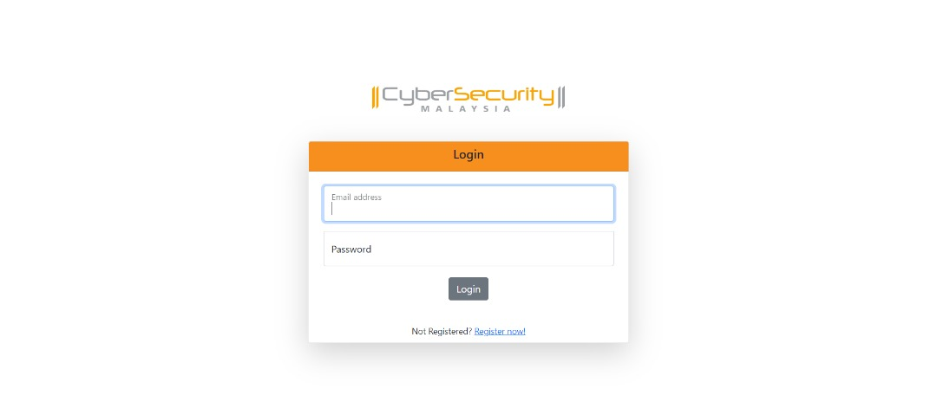
Snapshot of proposed solutions
Login Page

Slide 14
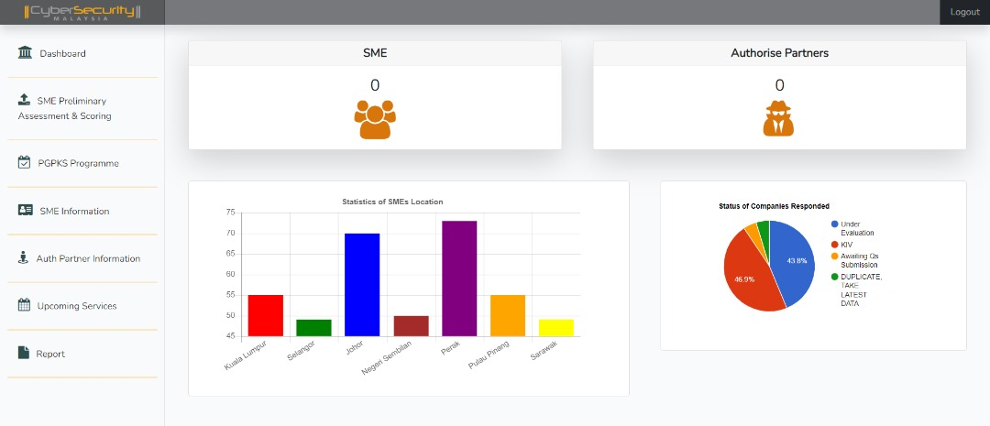
Snapshot of proposed solutions
Dashboard

Slide 15
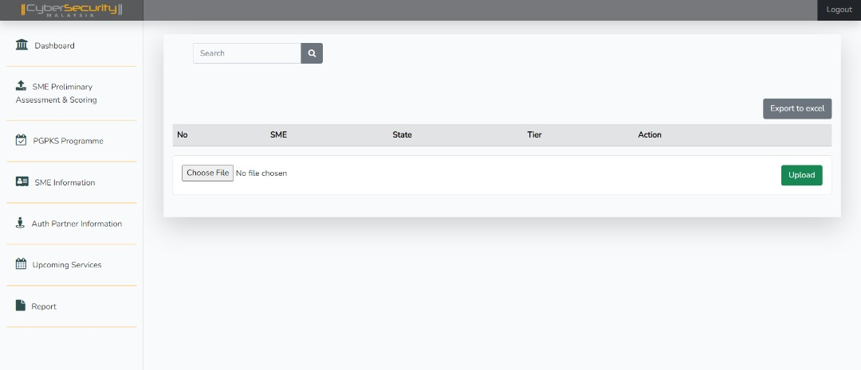
Snapshot of proposed solutions
Import/Export Excel File

Slide 16
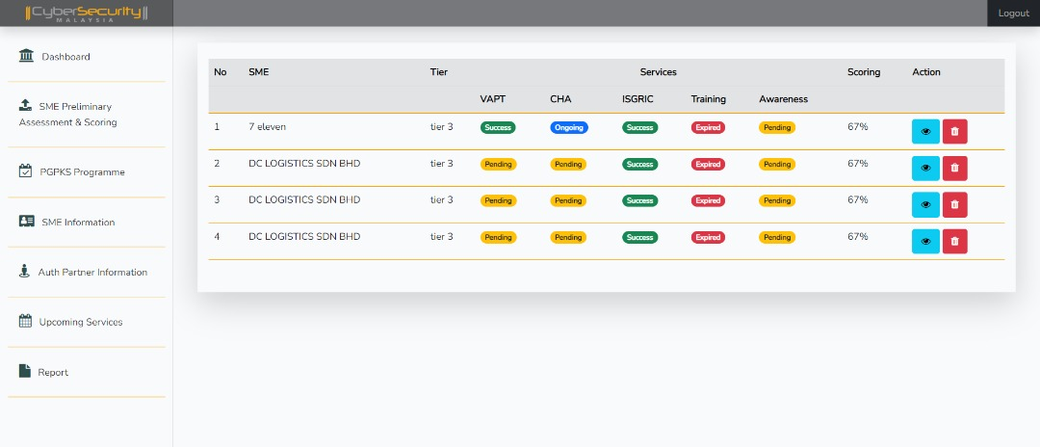
Snapshot of proposed solutions
Monitoring SMEs service

Slide 17
Detail list of deliverables/outputs
List all deliverable task with percentage completion
Admin
Authorization Partner
Dashboard 70%
SME Preliminary Assessment & Scoring 60%
PGPKS Programme 5%
SME Information 90%
Authorization Partner Information 80%
Upcoming Services 90%
Report 5%
Dashboard 5%
Event 10%
Profile 5%
Report 5%

Slide 18
New Knowledge
Folder Structure
Laravel
Database Migration
Blade Templating engine
Authentication and authorization

Slide 19
New Experience
Folder Structure
Laravel
Database Migration
Blade Templating engine
Authentication and authorization

Slide 20
Issue and limitations
01
02
03
PHP Version is not compatible with other version and can’t combine the project
Some upgrades might be problematic
Lack of continuation between versions. No transition from Laravel 4 to 5

Slide 21
Lesson Learned
Authenticcation And Authorization Role
Lesson Learned
Understanding CRUD
MVC Design Pattern.

Slide 22
Conclusion
The incredible features of Laravel have made it one of the most loved frameworks nowadays. Apart from this, extensive community support is provided for its users, which makes it approachable and understandable by all its users. Laravel is scalable and helps in software delivery in a fast and cost-effective manner. Therefore, not a big problem finding developers to work on this framework.

Slide 23
Thank You

